Slide 1
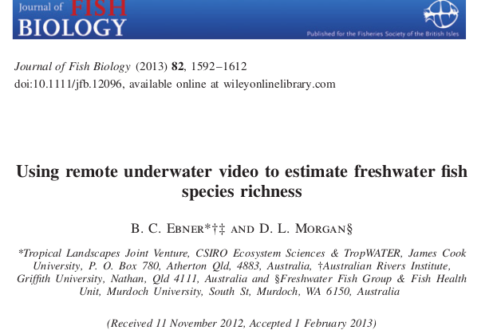
Amieroh Abrahams 3559244 • Kylen Brown 3540337 • Kim Scholtz 3571589
University of the Western Cape

Slide 2
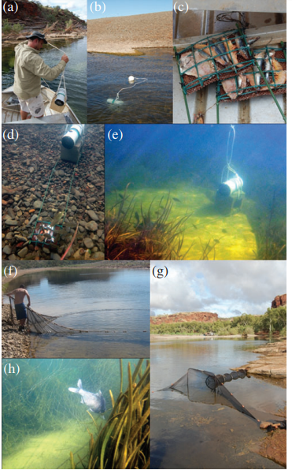
Introduction
Using remote underwater video to estimate freshwater fish species richness
Sampled inland fish in central and northern Australia
Different netting techniques
Netting techniques threaten a variety of species
BRUVs and UBRUVs

Slide 3
Aims
To test different video deployment techniques
To compare species richness estimates based on remote underwater video and conventional netting techniques
To explore strategies for combining different survey techniques

Slide 4
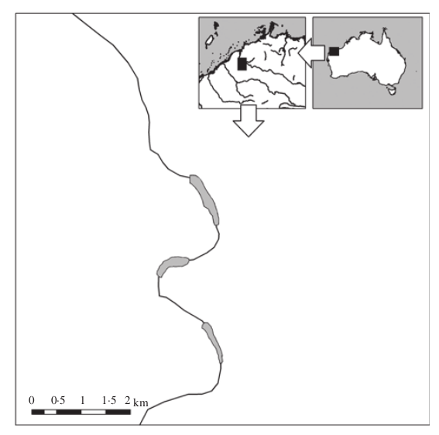
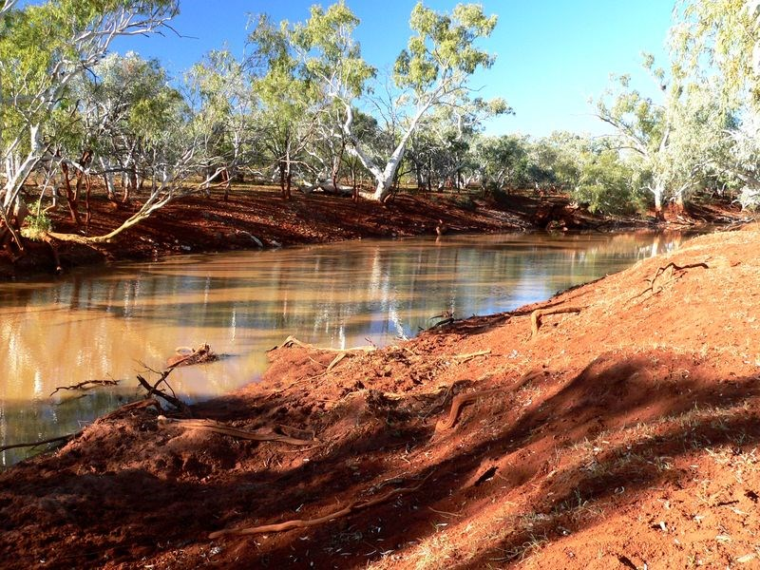
Study area
Western Fortescue River catchment in Pilbara Western Australia
1
2
3
The location of the Fortescue River in Western Australia and the three waterholes

Slide 5
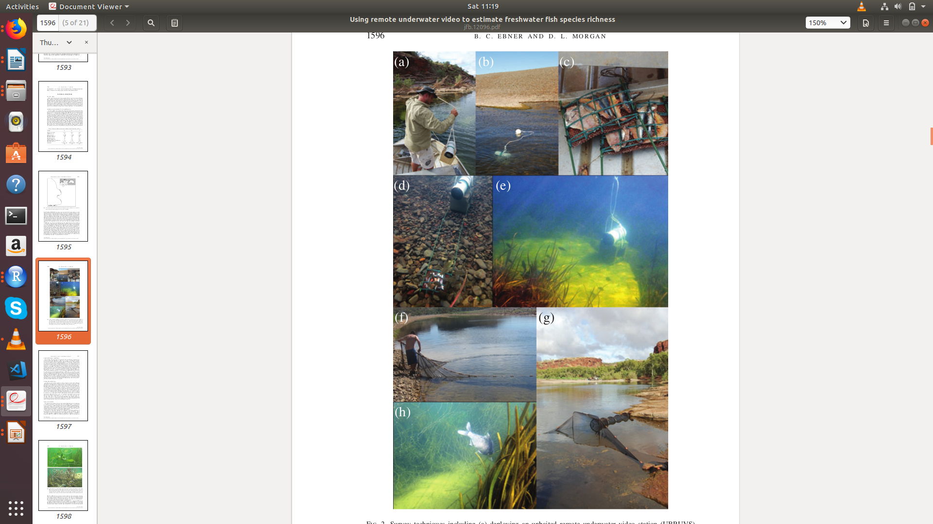
Methods
Camera deployment
Daylight sampling
UBRUVs at different depths
Sony HandiCam (HDRXR550)
Cameras placed 50m apart

Slide 6
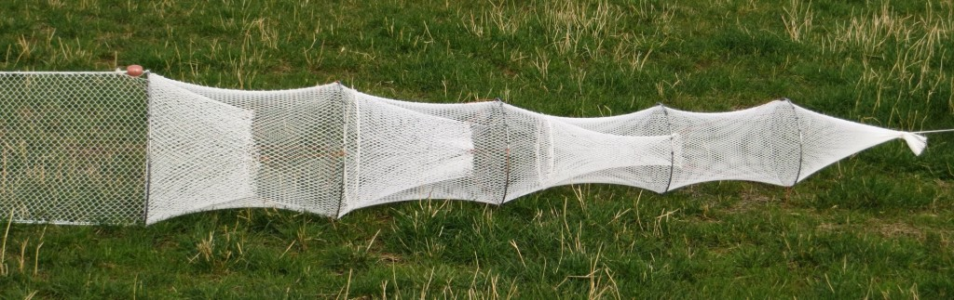
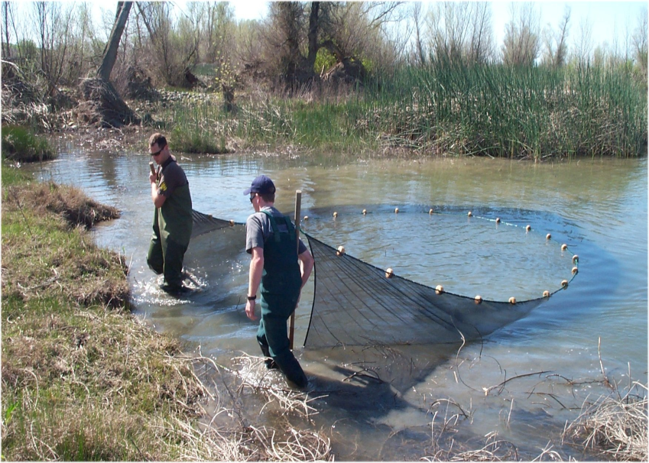
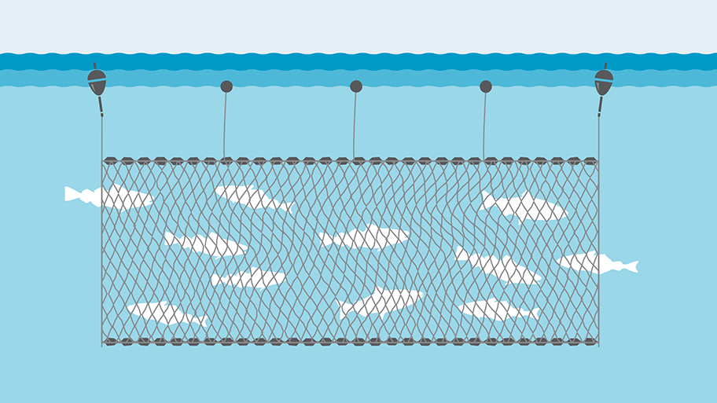
Methods
Conventional netting
Beach seining
Fyke nets
Multi-panel gillnet
Fish caught in the nets were counted and measured

Slide 7
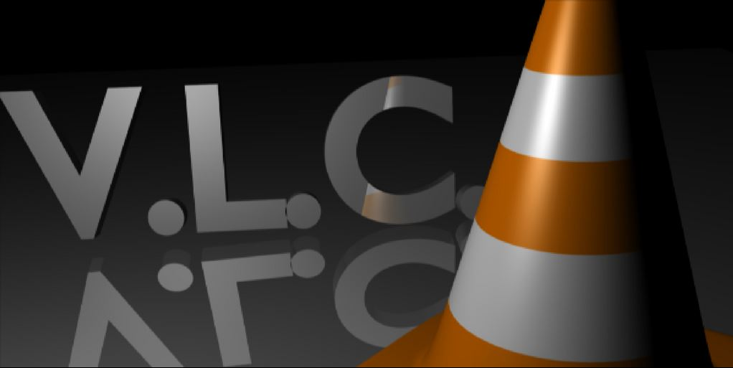
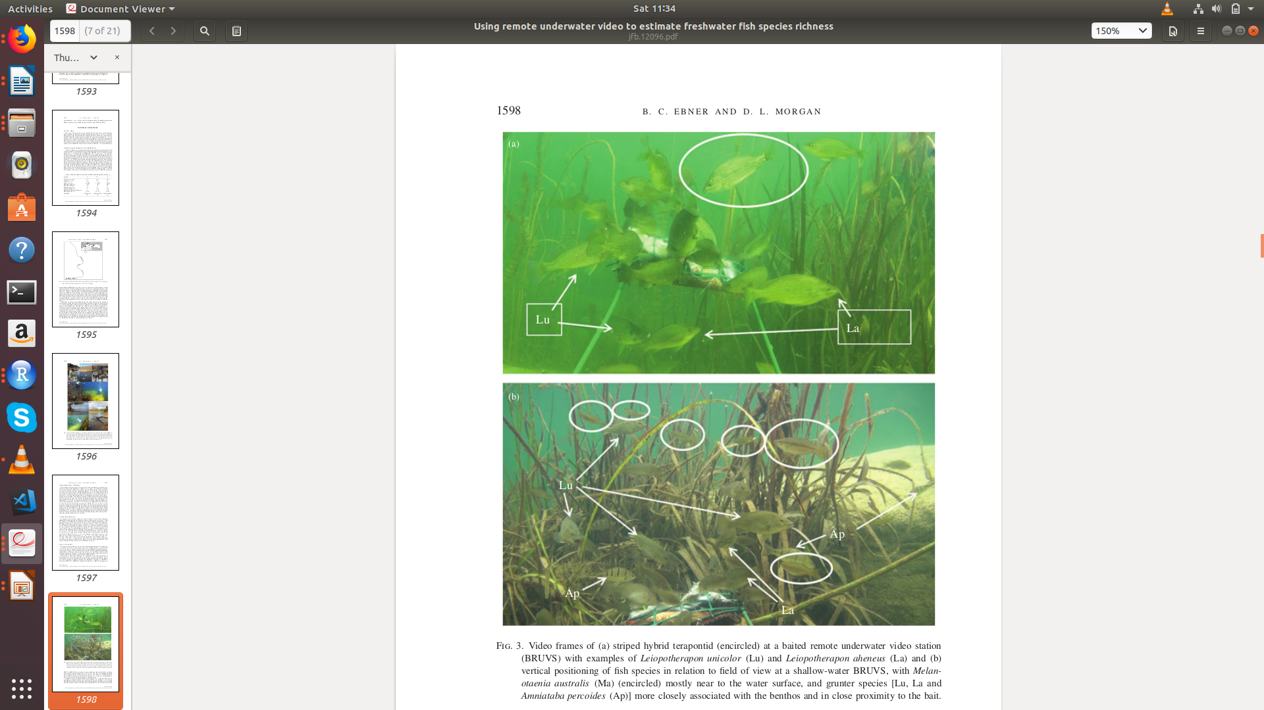
Methods
Video processing
VLC Media Player
Viewed first 10mins after deployment
Recorded first time arrival of each species in view

Slide 8
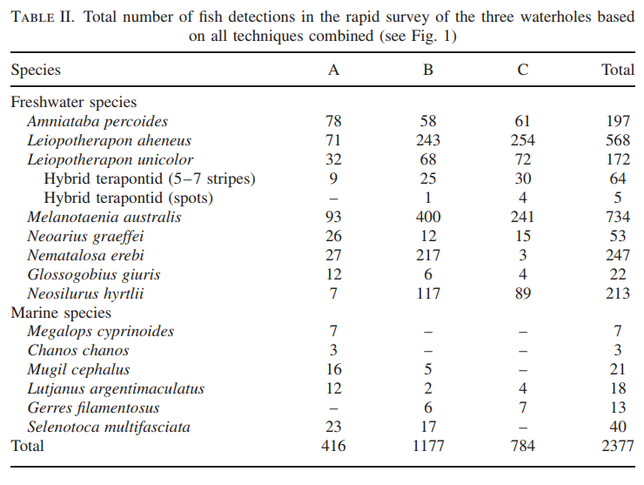
Data analysis
Presence or absence
Average catch was determined in relation to each technique
Species accumulation curves
Bray-Curtis similarity matrix
One-way ANOSIM

Slide 9
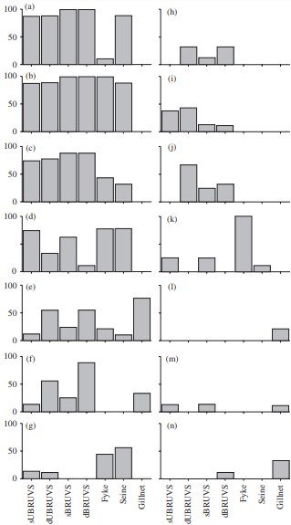
Results
Survey techniques and species richness estimates
Camera based techniques outperformed conventional netting techniques
Camera techniques yield 13 species
Netting technique yield 11 species
Three species were detected on camera that were not detected by netting techniques
Frequency of occurrence (%)
Survey technique

Slide 10
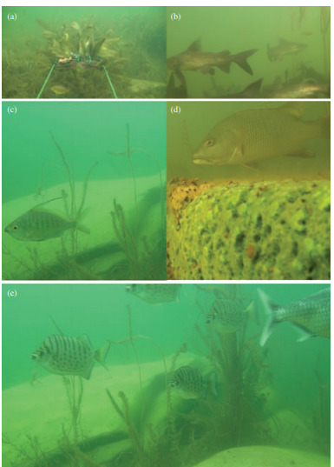
Results
Specie-specific detection
ANOSIM: Significant difference between pairwise comparison
Three Terapontidae species were recorded on camera
Species captured using different nets

Slide 11
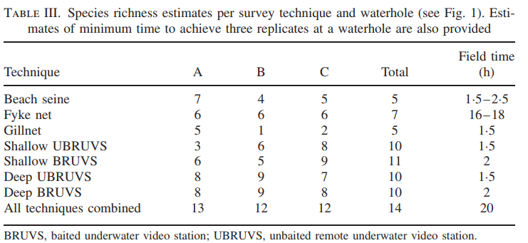
Discussion
Comparing survey techniques
No single sampling technique is adequate for detecting all fish
Limitations of conventional netting
1 Species detected by conventional netting and not cameras
Useful attributes of underwater video

Slide 12
Discussion
Survey strategies: Comparing alpha diversity
Netting strategies performed poorly
Combined strategies performed best in calculating species diversity

Slide 13
Conclusion
Versatile camera based techniques
Differences in baited and unbaited camera species richness detection

